Slide 1
Improved Logical Error Rate via List Decoding of Quantum Polar Codes
Anqi Gong and Joseph M. Renes
ETH Zürich
ISIT 2024
Athens, Greece
July 11

Slide 2
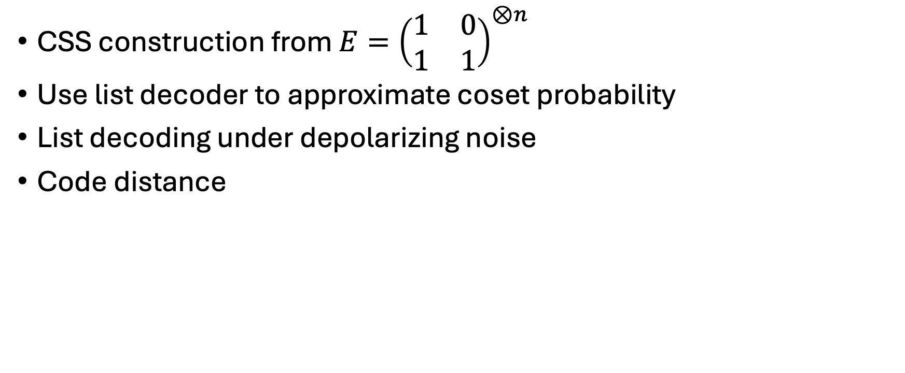
Outline
CSS construction from $E={\left(\begin{matrix}1 & 0 \\ 1 & 1\end{matrix}\right)}^{⊗n}$
Use list decoder to approximate coset probability
List decoding under depolarizing noise
Code distance

Slide 3
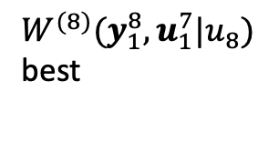


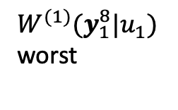









Phase flips sees things in the reversed way
$$u_{1}$$
$u_{1}⊕u_{2}$
$$y_{1}$$
$$W^{\left(1\right)}(y_{1},y_{2}|u_{1})$$
X
H
H
=
$$u_{2}$$
$$u_{2}$$
$$y_{2}$$
H
X
H
Z
$$W^{\left(2\right)}(y_{1},y_{2},u_{1}|u_{2})$$
Protect bit-flips
Protect phase-filps
$$| ⟩$$
$$| ⟩$$
$W^{(1)}(y_{1}^{8}|u_{1})$
worst
best
0
0
0
H
H
H
H
H
X
H
Z
=
H
H
H
H
X
$$\left|+\right\rangle$$
$$\left|+\right\rangle$$
$$|+⟩$$
H
$$\left|0\right\rangle$$
$$\left|0\right\rangle$$
$$|0⟩$$
H
H
H
$W^{(8)}(y_{1}^{8},u_{1}^{7}|u_{8})$
best
H
H
worst

Slide 4










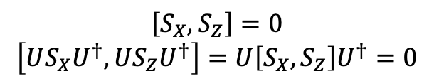

A CSS construction by specifying input state
As long as no qubit is simultaneously frozen in $|0⟩$ and $|+⟩$
X-type stabilizers commute with Z-type stabilizers
Why need “entanglement assistance” previously?
Unitary $U$
Qubit
0
1
2
3
4
5
6
7
$$|0⟩$$
X
🌟
X
$$|0⟩$$
Z
Z
Z
Z
$$|+⟩$$
Z
Z
Z
quantum
info
$$|0⟩$$
X
X
X
$$|+⟩$$
X
X
X
X
🌟
Z
$$|+⟩$$
Z
$$S_{X}=X_{5}$$
$$US_{X}U^{†}=X_{0}X_{1}X_{4}X_{5}$$
Precoding
$$S_{Z}=Z_{2}$$
$$US_{Z}U^{†}=Z_{2}Z_{3}Z_{6}Z_{7}$$
$$\left[S_{X}, S_{Z}\right]=0$$
$$\left[US_{X}U^{†}, US_{Z}U^{†}\right]=U\left[S_{X},S_{Z}\right]U^{†}=0$$

Slide 5





A CSS construction by specifying input state
As long as no qubit is simultaneously frozen in $|0⟩$ and $|+⟩$
X-type stabilizers commute with Z-type stabilizers
Why need “entanglement assistance” previously?
Unitary $U$
Qubit
Against bit flips
Against phase flips
0
1
2
3
4
5
6
7
$$|0⟩$$
0
7
4
6
3
5
$$|0⟩$$
$$|+⟩$$
1
2
$$|0⟩$$
$$|+⟩$$
2
1
5
3
6
4
$$|+⟩$$
7
0
freeze 3 worst
freeze 3 worst

Slide 6









Polarization Weight (PW) construction
[1,2]
Avoid frozen set intersection
Want to define Polarization Weight of row 6
$$6={110}_{2}=1×2^{2} +1×2^{1}+0×2^{0}$$
$${{PW}_{β}\left(6\right)=110}_{β}=1×β^{2}+1×β^{1}+0×β^{0}$$
Against bit flips
Against phase flips
Bin
PW $β=2^{1/4}$
PW $β=2^{1/4}$
$$|0⟩$$
Row 0
000
0
3.603
$$|0⟩$$
Row 1
001
1
2.603
$$|0⟩$$
Row 2
010
1.189
2.414
🌟
Row 3
011
2.189
1.414
🌟
Row 4
100
1.414
2.189
$$|+⟩$$
Row 5
101
2.414
1.189
$$|+⟩$$
Row 6
110
2.603
freeze 3 best
1
$$|+⟩$$
Row 7
111
3.603
0
Want an $[\left[8, 2\right]]$ quantum code
freeze 3 worst
freeze 3 worst

Slide 7






Reuse decoder on classical component codes
Independent bit- and phase-flip: decode two components separately
correct bit-flips
correct phase-flips
$$| ⟩$$
$$| ⟩$$
H
0
0
0
H
H
H
H
H
🌟
H
H
🌟
H
H
$$|+⟩$$
$$| ⟩$$
$$| ⟩$$
$$|+⟩$$
H
0
0
0
H
$$|+⟩$$
$$|+⟩$$
H
H
$$|+⟩$$
$$|+⟩$$
H
H
[8,5] classical code

Slide 8


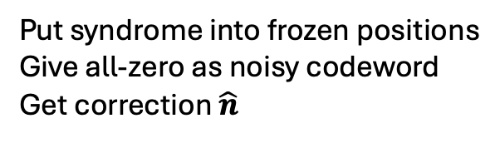
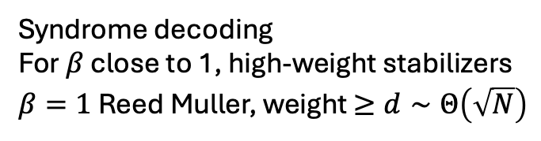

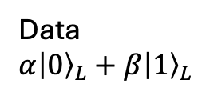


Use List decoder on classical component codes
Independent bit- and phase-flip: decode two components separately
e.g., want to correct bit-flips.
Codeword decoding (Steane extraction)
Syndrome decoding
For $β$ close to 1, high-weight stabilizers
$β=1$ Reed Muller, weight $≥d∼Θ\left(\sqrt{N}\right)$
Data
$$α{\left|0\right\rangle }_{L}+β{\left|1\right\rangle }_{L}$$
Correction $y−\hat{c}=\hat{n}$
Put syndrome into frozen positions
Give all-zero as noisy codeword
Get correction $\hat{n}$
Ancilla ${\left|+\right\rangle }_{L}$
Noisy codeword $y$
Closest codeword $\hat{c}$
Degeneracy: still correct if $\hat{n}$ and $n$ differ by a stabilizer

Slide 9
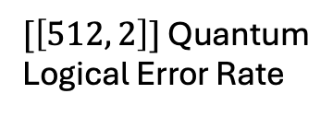
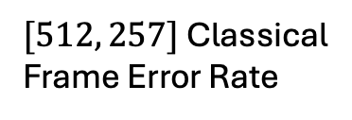

Impact of list size
$[512, 257]$ Classical
Frame Error Rate
L=1
L=2
L=4
L=16
$[\left[512, 2\right]]$ Quantum
Logical Error Rate
Bit-flip error rate
Classical Error Correction: wrong if $\hat{n}≠n$
Quantum Error Correction: still correct if $\hat{n}$ and $n$ differ by a stabilizer
What’s on the list? (with high probability)
Given syndrome $s$, most likely $\hat{n}$’s compatible with $s$

Slide 10
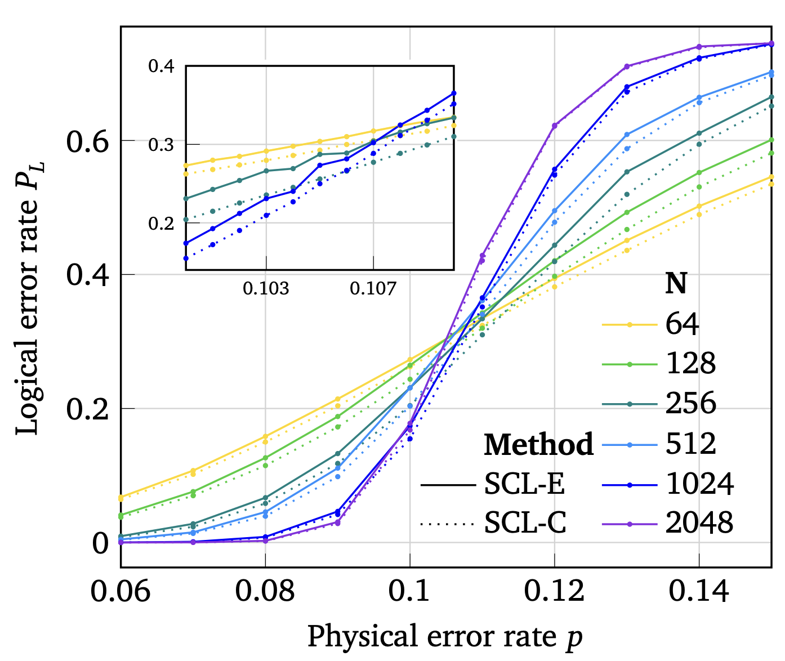
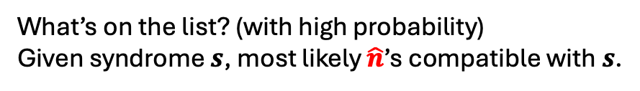
Improvement in $[\left[N,2\right]]$ PW Quantum Polar Codes ($L=128$)
Quantum Error Correction: still correct if $\hat{n}$ and $n$ differ by a stabilizer
Partition error strings compatible with the syndrome into equivalence classes.
Classical MLD: Choose the most likely error string
Quantum MLD: Choose the most likely error class
Classical near MLD
Approximated Quantum MLD via List Decoder
Low weight (most likely) noise strings contribute the most to error class probability calculation
What’s on the list? (with high probability)
Given syndrome $s$, most likely $\hat{n}$’s compatible with $s$.

Slide 11






List decoding on depolarizing channel
$$|0⟩$$
$$|0⟩$$
$X,Y,Z$each prob. $p/3$
🌟
$$|0⟩$$
$$|+⟩$$
i.i.d.
🌟
$$|+⟩$$
$$|+⟩$$

Slide 12





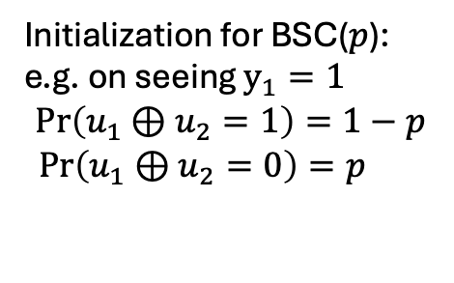






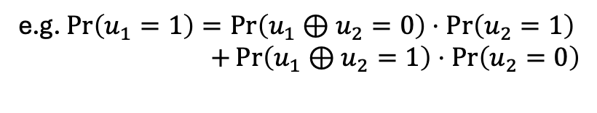






Successive Cancellation
* Omit $∙|y$ everywhere
List Decoding
Initialization for BSC($p$):
e.g. on seeing $y_{1}=1$
$$\operatorname{Pr}\left(u_{1}⊕u_{2}=1\right)=1−p$$
$\operatorname{Pr}\left(u_{1}⊕u_{2}=0\right)=p$
$${\hat{u}}_{1}⊕{\hat{u}}_{2}$$
$$u_{1}$$
$$u_{1}⊕u_{2}$$
$$y_{1}$$
${\hat{u}}_{1}$=
$$0$$
$${\hat{u}}_{2}$$
${\hat{u}}_{2}$=
$$0$$
$$u_{2}$$
$$u_{2}$$
$$y_{2}$$
${\hat{u}}_{3}$= ?
On seeing $y_{2}$, $Pr⁡(u_{2}= ∙ )$
$$0$$
$f_{+}$ rule: calculate $Pr⁡(u_{1}= ∙)$from $Pr⁡(u_{1}⊕u_{2}= ∙)$and $Pr⁡(u_{2}= ∙)$
e.g. $\operatorname{Pr}\left(u_{1}=1\right)=\operatorname{Pr}\left(u_{1}⊕u_{2}=0\right)⋅\operatorname{Pr}\left(u_{2}=1\right)$
$+\operatorname{Pr}\left(u_{1}⊕u_{2}=1\right)⋅\operatorname{Pr}\left(u_{2}=0\right)$
$f_{−}$ rule: $Pr⁡(u_{2}= ∙|{ u}_{1}={\hat{u}}_{1})$from ${\hat{u}}_{1}$, $Pr⁡(u_{1}⊕u_{2}= ∙)$and $Pr⁡(u_{2}= ∙)$
e.g. $\operatorname{Pr}\left(u_{2}=1|…\right)=\operatorname{Pr}\left(u_{1}⊕u_{2}=1⊕{\hat{u}}_{1}\right)⋅\operatorname{Pr}\left(u_{2}=1\right)/$ … (normalize)
Path metric update (initialized to 1): if $u_{i}$ frozen (to 0), ${\hat{u}}_{i}=0$
otherwise explore both ${\hat{u}}_{i}=0/1$
$$PM\left({\hat{u}}_{0}^{i}\right)=PM\left({\hat{u}}_{0}^{i−1}\right)⋅\operatorname{Pr}\left(u_{i}={\hat{u}}_{i}|…\right)$$

Slide 13

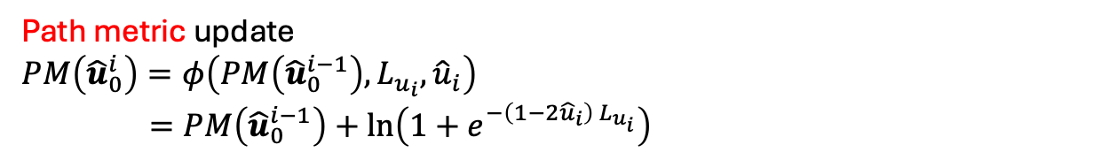





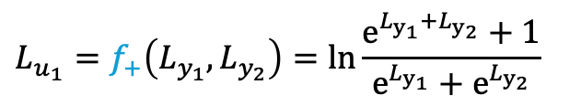




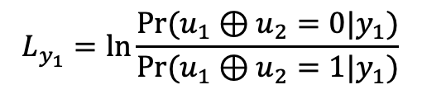
Successive Cancellation
List Decoding
LLR version
$$u_{1}$$
$$u_{1}⊕u_{2}$$
$$y_{1}$$
$$0$$
$$L_{y_{1}}=\ln{\frac{Pr⁡(u_{1}⊕u_{2}=0|y_{1})}{\operatorname{Pr}{(u_{1}⊕u_{2}=1|y_{1})}}}$$
$$0$$
$$u_{2}$$
$$u_{2}$$
$$y_{2}$$
$$0$$
$$L_{u_{1}}=f_{+}\left(L_{y_{1}}, L_{y_{2}}\right)=ln\frac{e^{L_{y_{1}}+L_{y_{2}}}+1}{e^{L_{y_{1}}}+e^{L_{y_{2}}}}$$
$$L_{u_{2}}=f_{−}\left(L_{y_{1}},L_{y_{2}},{\hat{u}}_{1}\right)=L_{y_{1}}{\left(−1\right)}^{{\hat{u}}_{1}}+L_{y_{2}}$$
Path metric update
$$PM\left({\hat{u}}_{0}^{i}\right)=φ\left(PM\left({\hat{u}}_{0}^{i−1}\right), L_{u_{i}},{\hat{u}}_{i}\right)$$
$=PM\left({\hat{u}}_{0}^{i−1}\right)+\ln\left(1+e^{−\left(1−2{\hat{u}}_{i}\right) L_{u_{i}}}\right)$

Slide 14











List decoding on depolarizing channel
$Z$ $X$
0
$${\hat{v}}_{8}$$
$$|0⟩$$
0
$${\hat{v}}_{7}$$
$$|0⟩$$
$${\hat{u}}_{3}$$
$${\hat{v}}_{6}$$
$X,Y,Z$each prob. $p/3$
🌟
0
$${\hat{v}}_{5}$$
$$|0⟩$$
$${\hat{u}}_{5}$$
0
$$|+⟩$$
i.i.d.
$${\hat{u}}_{6}$$
$${\hat{v}}_{3}$$
🌟
$${\hat{u}}_{7}$$
0
$$|+⟩$$
$${\hat{u}}_{8}$$
0
$$|+⟩$$

Slide 15






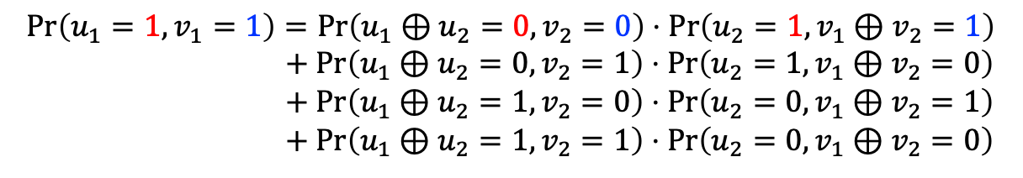





* Omit $∙|y$ everywhere
Initialization: If observed noisy version for $u_{1}⊕u_{2},v_{2}$ is $1,0$
$$\left(U,V\right) = \left(0,0\right) \left(0,1\right) \left(1,0\right) (1,1)$$
$$u_{1} , v_{2}$$
$$u_{1}⊕u_{2},v_{2}$$
$$\operatorname{Pr}\left(u_{1}⊕u_{2}=U,v_{2}=V\right) =$$
$$p/3$$
$$p/3$$
$$1−p$$
$$p/3$$
$$u_{2} , v_{1}$$
$$u_{2},v_{1}⊕v_{2}$$
$f_{+}$ rule: obtain $Pr⁡(u_{1}= ∙ , v_{1}= ∙ )$ from $Pr⁡({u_{1}⊕u}_{2}= ∙ , v_{2}= ∙ )$ and $Pr⁡(u_{2}= ∙ , v_{1}⊕v_{2}= ∙ )$
$$\operatorname{Pr}\left(u_{1}=1,v_{1}=1\right)=\operatorname{Pr}\left(u_{1}⊕u_{2}=0,v_{2}=0\right)⋅\operatorname{Pr}\left(u_{2}=1,v_{1}⊕v_{2}=1\right)$$
$+ Pr\left(u_{1}⊕u_{2}=0,v_{2}=1\right)⋅\operatorname{Pr}\left(u_{2}=1,v_{1}⊕v_{2}=0\right)$
$+ Pr\left(u_{1}⊕u_{2}=1,v_{2}=0\right)⋅\operatorname{Pr}\left(u_{2}=0,v_{1}⊕v_{2}=1\right)$
$+ Pr\left(u_{1}⊕u_{2}=1,v_{2}=1\right)⋅\operatorname{Pr}\left(u_{2}=0,v_{1}⊕v_{2}=0\right)$
$f_{−}$ rule: obtain $Pr⁡(u_{2}= ∙ , v_{2}= ∙|…)$ from ${\hat{u}}_{1},{\hat{v}}_{1}$, $Pr⁡({u_{1}⊕u}_{2}= ∙ , v_{2}= ∙ )$ and $Pr⁡(u_{2}= ∙ , v_{1}⊕v_{2}= ∙ )$
$\operatorname{Pr}\left(u_{2}=1,v_{2}=1|…\right)=\operatorname{Pr}\left(u_{1}⊕u_{2}=1⊕{\hat{u}}_{1},v_{2}=1\right)⋅\operatorname{Pr}\left(u_{2}=1,v_{1}⊕v_{2}=1⊕{\hat{v}}_{2}\right)/$…
Path metric update: if $(u_{i},v_{i})$ frozen, ${\hat{u}}_{i}=0, {\hat{v}}_{i}=0$
otherwise explore $({\hat{u}}_{i},{\hat{v}}_{i})=(0,0)/(0,1)/(1,0)/(1,1)$
$$PM∗=\operatorname{Pr}\left(u_{i}={\hat{u}}_{i},v_{i}={\hat{v}}_{i}|…\right)$$

Slide 16
























$$u_{1},v_{8}$$
$$u_{2},v_{7}$$
$$u_{1} , v_{2}$$
$$u_{1}⊕u_{2},v_{2}$$
$$u_{3},v_{6}$$
$$u_{4},v_{5}$$
$$u_{5},v_{4}$$
$$u_{2} , v_{1}$$
$$u_{2},v_{1}⊕v_{2}$$
$$u_{6},v_{3}$$
$$u_{7},v_{2}$$
$$u_{8},v_{1}$$
Same at the output
$$u_{1},v_{1}$$
$$u_{2},v_{2}$$
$$u_{1} , v_{1}$$
$$u_{1}⊕u_{2},v_{2}$$
$$u_{3},v_{3}$$
$$u_{4},v_{4}$$
$$u_{2} , v_{2}$$
$$u_{2},v_{1}⊕v_{2}$$
$$u_{5},v_{5}$$
$$u_{6},v_{6}$$
$$u_{7},v_{7}$$
$$u_{8},v_{8}$$

Slide 17
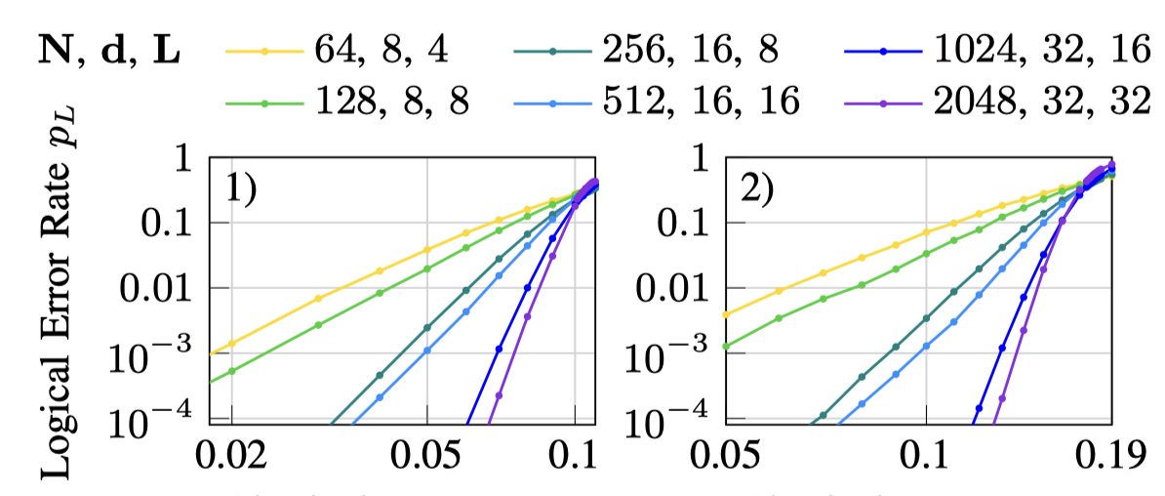



$[[N,2,d]]$PW-QPC $$β=2^{1/4}$$
BSC($p$)
Depolarize($p$)
10~11%
~18%

Slide 18


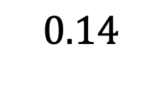


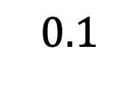



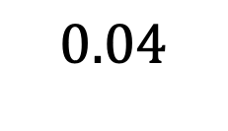

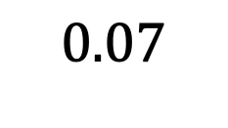




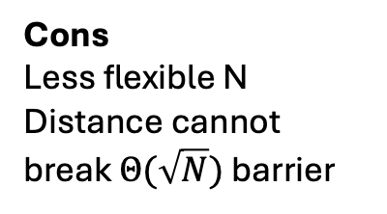
Comparison to QLDPC
PW-QPC, $L=16$
Pros
More flexible K
No error floor under list decoding
$$1$$
$\left[\left[256, 14, 16\right]\right]$, $β=1.13$
$$0.01$$
$\left[\left[256, 28, 16\right]\right]$, $β=1.13$
Cons
Less flexible N
Distance cannot break $Θ(\sqrt{N})$ barrier
$\left[\left[1024, 28, 32\right]\right]$, $β=1.08$
$${10}^{−4}$$
QLDPC, BP4+OSD0
$${10}^{−6}$$
$$\left[\left[254, 14, 16\right]\right]$$
$$0.04$$
$$0.07$$
$$0.1$$
$$0.14$$
$$\left[\left[254, 28,≤20\right]\right]$$
Depolarize($p$)
$$\left[\left[882, 24, ≤24\right]\right]$$

Slide 19


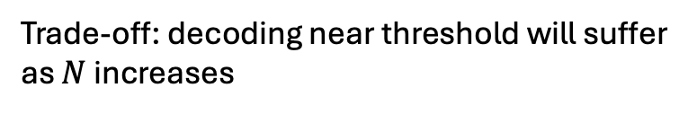

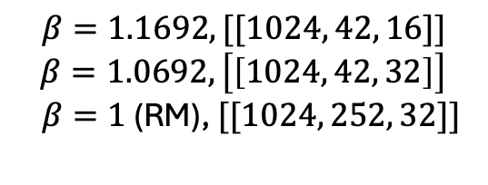

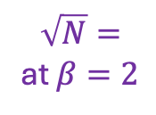
Code Distance (impact of $β$)
$β→1$, approaching Reed-Muller (maximum rate distance tradeoff from $E$)
$β=1.1692, [[1024, 42, 16]]$
$$β=1.0692, \left[\left[1024, 42, 32\right]\right]$$
$β=1$ (RM), $[[1024, 252, 32]]$
Distance 2 at $β=2$
$$\sqrt{N}=$$
at $β=2$
$$d_{X}=\min{\{wt\left(x\right), x∈C_{Z}\backslash C_{X}^{⊥}\}}$$
Trade-off: decoding near threshold will suffer
as $N$ increases
$$d_{Z}=\min{\{wt\left(x\right), x∈C_{X}\backslash C_{Z}^{⊥}\}}$$
A. Goswami, M. Mhalla, and V. Savin, “Fault-tolerant preparation of quantum polar codes encoding one logical qubit,” Phys. Rev. A, vol. 108, 2023.

Slide 20
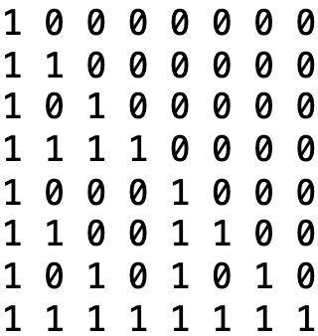
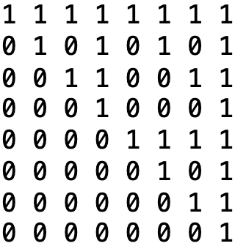
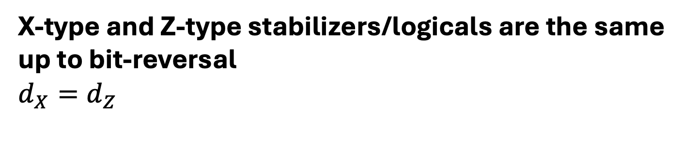





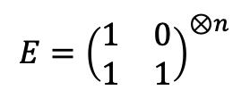

X-type and Z-type stabilizers/logicals are the same
up to bit-reversal
$$d_{X}=d_{Z}$$
$$E={\left(\begin{matrix}1 & 0 \\ 1 & 1\end{matrix}\right)}^{⊗n}$$
$$E^{T}={\left(\begin{matrix}1 & 1 \\ 0 & 1\end{matrix}\right)}^{⊗n}$$
Qubit
0
1
2
3
4
5
6
7
$$|0⟩$$
X
🌟
X
$$|0⟩$$
Z
Z
Z
Z
$$|+⟩$$
Z
Z
Z
$$|0⟩$$
X
X
X
$$|+⟩$$
X
X
X
X
🌟
Z
$$|+⟩$$
Z
Logical Hadamard = tranversal Hadamard + qubit reversal
$$d_{X}=\min{\{wt\left(x\right), x∈C_{Z}\backslash C_{X}^{⊥}\}}$$

Slide 21
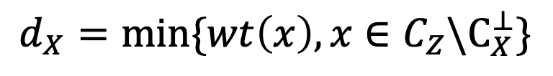
X-type and Z-type stabilizers/logicals are the same
up to bit-reversal
$$d_{X}=d_{Z}$$
$$d_{X}=\min{\{wt\left(x\right), x∈C_{Z}\backslash C_{X}^{⊥}\}}$$
Qubit
0
1
2
3
4
5
6
7
$$|0⟩$$
X
🌟
X
$$|0⟩$$
Z
Z
Z
Z
$$|+⟩$$
Z
Choose at least one
Z
Z
$$|0⟩$$
X
X
X
$$|+⟩$$
X
X
X
X
🌟
Z
$$|+⟩$$
Z
Choose arbitrarily
Distance = Minimum weight of all choices
Conjecture: for PW-QPC ($1≤β≤2$), distance = min{wt(logical rows)}

Slide 22




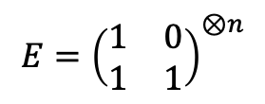
Conjecture: for PW-QPC ($1≤β≤2$), distance = min{wt(logical rows)}
We show this is true for many cases
By using a lemma
If stabilizer row above some logical row but has smaller weight ☹️
$$E={\left(\begin{matrix}1 & 0 \\ 1 & 1\end{matrix}\right)}^{⊗n}$$
$PW_{2}($stab$)<PW_{2}($log$)$
$PW_{β}($stab$)>PW_{β}($log$)$
If stabilizer row above
logical rows but
has same weight 👍
$PW_{1}($stab$)<PW_{1}($log$)$
Get weight $≥$ wt( )
Rare!
If all stabilizer rows
are below any
logical rows 👍
Choose arbitrary rows below
V.-F. Drǎgoi, M. Rowshan, and J. Yuan, “On the closed-form weight enumeration of polar codes: 1.5d-weight codewords,” IEEE Transactions on Communications, 2024.

Slide 23
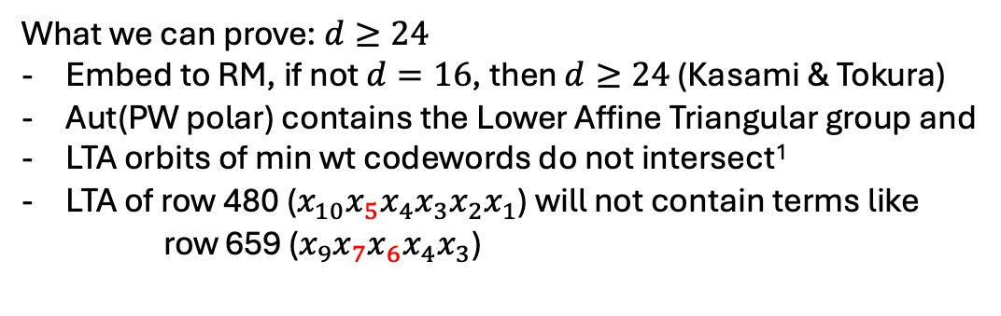
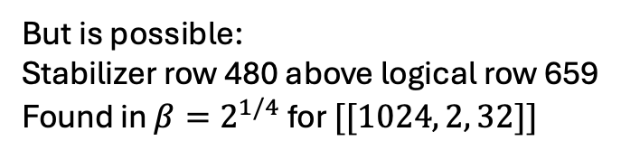
Conjecture: for PW-QPC ($1≤β≤2$), distance = min{wt(logical rows)}
If stabilizer row above some logical row but has smaller weight ☹️
What we can prove: $d≥24$
Embed to RM, if not $d=16$, then $d≥24$ (Kasami & Tokura)
Aut(PW polar) contains the Lower Affine Triangular group and
LTA orbits of min wt codewords do not intersect¹
LTA of row 480 ($x_{10}x_{5}x_{4}x_{3}x_{2}x_{1}$) will not contain terms like
row 659 ($x_{9}x_{7}x_{6}x_{4}x_{3}$)
$PW_{2}($stab$)<PW_{2}($log$)$
$PW_{β}($stab$)>PW_{β}($log$)$
$PW_{1}($stab$)<PW_{1}($log$)$
RM codewords of wt $[d,2d]$are characterized by Kasami & Tokura
Rare!
But is possible:
Stabilizer row 480 above logical row 659
Found in $β=2^{1/4}$ for $[[1024, 2, 32]]$
Confirmed by list decoder
¹M. Bardet, V. Drǎgoi, A. Otmani, and J.-P. Tillich, “Algebraic properties of polar codes from a new polynomial formalism,” ISIT 2016

Slide 24
Conclusion
PW construction can be used to construct CSS QPC
List decoding under data depolarizing noise
To be explored
Precoding
Distance conjecture, prove completely or disprove
Fault-tolerant state preparation

